Slide 1
Network Layer: Unicast Routing
Covers Chapter# 20 from Text Book
Computer Communication & Networks
(CEN-223)
Fall 2022 (BSE-5A)

Slide 2
Internet Structure
The Internet has changed from a tree-like structure, with a single backbone, to a multi-backbone structure run by different private corporations today.
Internet Structure

Slide 3
Internet Structure (Cont.)
There are several backbones run by private communication companies that provide global connectivity.
The backbones are connected by peering points that allow connectivity between the backbones.
Provider networks use the backbones for global connectivity but provide services to Internet customers.
Customer networks use services given by provider networks.
Any of these three entities (backbone, provider network, or customer network) can be called an ISP. They provide services, but at different levels.

Slide 4
Routing
Unicast routing: the process of delivering a datagram from source to destination in which the datagram is destined for only one destination (one-to-one delivery).
Routing is possible if a router has a routing table (also known as forwarding table).
A routing table can be either static or dynamic.
A static routing table is the one with manual entries.
A dynamic routing table is the one that is updated automatically when there is a change somewhere in the Internet.

Slide 5
Routing (Cont.)
In unicast routing, a packet is routed hop-by-hop from its source to its destination by the help of routing tables.
Only routers need routing tables. The source/destination hosts do not need routing tables, because the source delivers its packet to the default router in its local network, while the destination receives the packet from its default router in its local network.
Given that a packet can travel through several routes, the main question is that which route the packet should take for sending a packet from source to destination?

Slide 6
Autonomous System
The Internet is made of a huge number of networks and routers.
Routing in the Internet cannot be done using a single routing protocol for two reasons:
Scalability problem
Administrative issue
Hence, the internet is divided into autonomous systems.

Slide 7
Autonomous System (Cont.)
Autonomous system: a group of networks and routers under the authority of a single administration.
Routing inside an autonomous systems is intradomain routing.
Routing between autonomous systems is interdomain routing.

Slide 8
Internet as a Graph
To find the best route, the internet can be modeled as a graph.
Graph: a set of nodes and edges (lines) that connect the nodes.
To model an internet as a graph, we can think of each router as a node and each network between a pair of routers as an edge.
The internet is modeled as a weighted graph, in which each edge is associated with a cost.
In routing, the cost of an edge has different interpretation in different routing protocols.
If there is no edge between the nodes, the cost is infinity.

Slide 9
Internet as a Graph (Cont.)
An Internet and its graphical representation

Slide 10
Least-Cost Routing
When the internet is modeled as a weighted graph, one of the ways to interpret the best route is to find the least cost route between source and destination among all possible routes.
Each router needs to find the least-cost route between itself and all other routers to route a packet using the least-cost criteria.
The best route between A and E is A-B-E, with the cost of 6.
Bellman-Ford equation is used to find the least cost between a source and destination.

Slide 11
Routing Algorithms
Several routing algorithms exist:
Distance-Vector Routing
Link-State Routing
Path-Vector Routing
The difference is in the way they interpret the least cost and the way they create the least-cost tree for each node.
Routing protocols implement one of these algorithms.

Slide 12
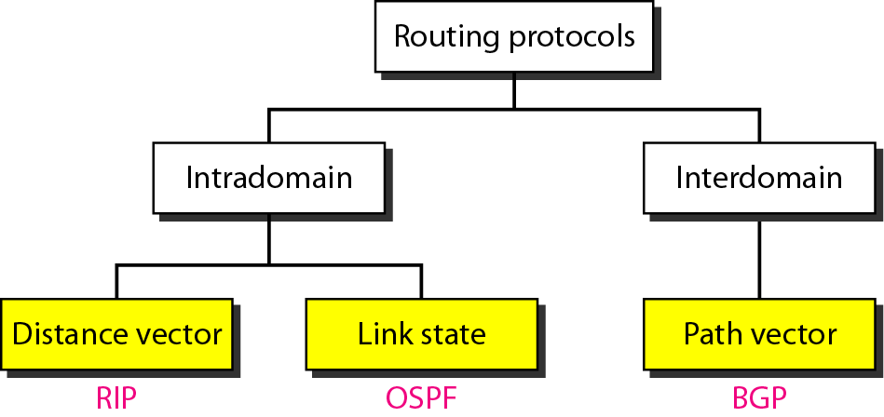
Routing Algorithms (Cont.)
Routing Algorithm
Routing Protocols

Slide 13
Routing Protocol
Routing protocol: is a combination of rules and procedures that lets routers inform each other of changes.
Routing protocols are used to create and update routing tables.
Each routing protocol is based on an algorithm.
However, the routing protocol is more than an algorithm, where a protocol needs to define its domain of operation, the messages exchanged, communication between routers and interaction with protocols in other domains.

Slide 14
Distance-Vector Routing

Slide 15
Distance-Vector Routing
In distance vector routing, the least-cost route between any two nodes is the route with minimum distance.
Each node maintains a table of minimum distances to every node.
The table at each node also guides the packets to the desired node by showing the next stop in the route (next-hop routing).
Each node shares its routing table with its immediate neighbors periodically and when there is a change.
Once the tables are shared and updated, the tables are stable where each node knows how to reach any other node and the cost.

Slide 16
Distance-Vector Routing: Initialization
At the beginning, stable tables do not exist, where each node can know only the distance between itself and its immediate neighbors, i.e. those directly connected to it.
So for the moment, we assume that each node can send a message to the immediate neighbors and find the distance between itself and these neighbors.
The distance for any entry that is not a neighbor is marked as infinite (unreachable).

Slide 17
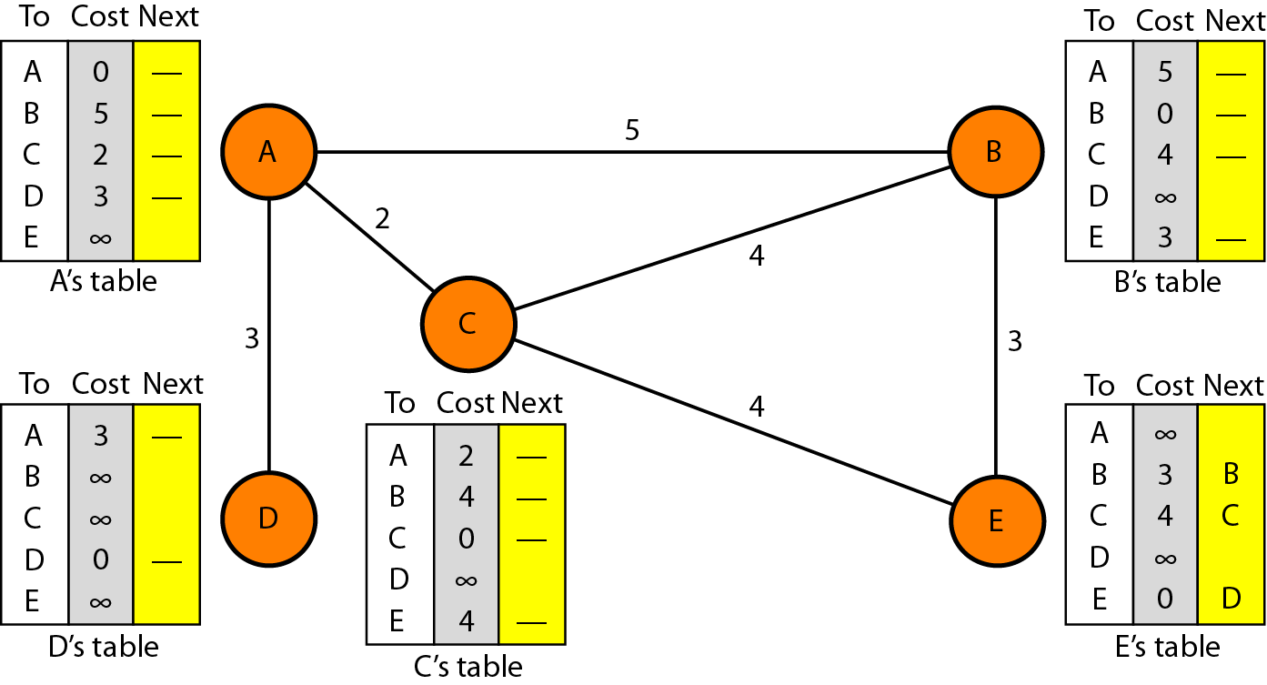
Distance-Vector Routing: Initialization (Cont.)
Initialization of tables in distance vector routing

Slide 18
Distance-Vector Routing: Sharing & Updating
A node shares only the first two columns of its table to neighbor.
Updating takes three steps:
The receiving node needs to add the cost between “itself and the sending node” to each value in the second column of received table.
The receiving node needs to add the name of the sending node to each row, as the third column.

Slide 19
Distance-Vector Routing: Sharing & Updating (Cont.)
The receiving node needs to compare each row of its old table with corresponding row of modified version of received table.
If next-node entry is different, the receiving node chooses the row with smaller cost. If there is a tie in cost, the old entry is kept.
If next-node entry is same, the receiving node chooses the new row.
In a short time, if there is no change in the network, each node reaches a stable condition in which the contents of its table remains the same.

Slide 20
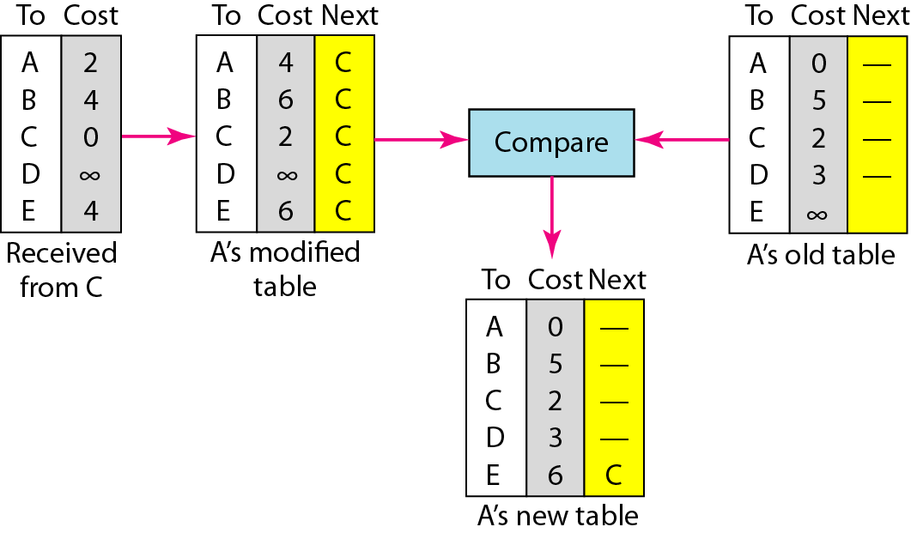
Distance-Vector Routing: Sharing & Updating (Cont.)
The only benefit from updating of node A is the last entry, i.e. how to reach E.
Previously, node A did not know how to reach E (i.e. the distance was ∞).
Now it knows that the cost is 6 via C.
Updating in distance vector routing

Slide 21
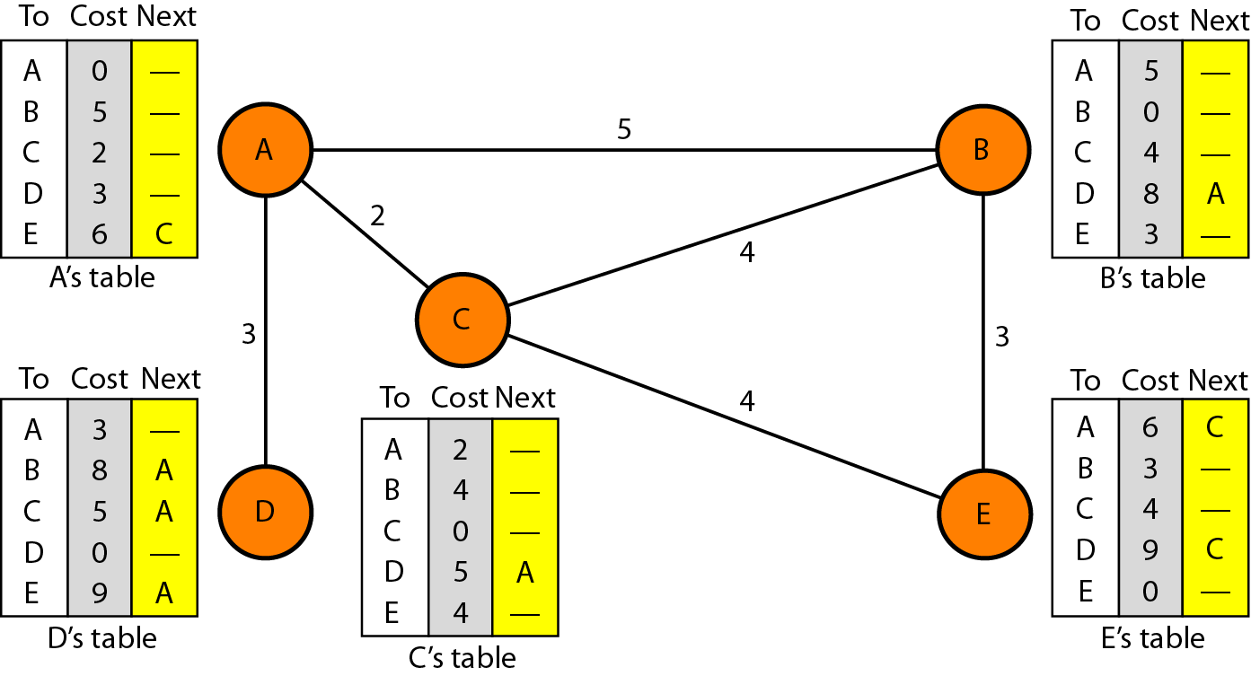
Distance-Vector Routing (Cont.)
Distance vector routing tables

Slide 22
Distance-Vector Routing: Sharing & Updating (Cont.)
When to Share? The table is sent both periodically and when there is a change in the table.
Periodic Update: a node sends its routing table, normally every 30s, in a periodic update. The period depends on the protocol that is using distance vector routing.
Triggered Update: a node sends its routing table to its neighbors any time there is a change in its routing table.

Slide 23
Link-State Routing

Slide 24
Link State Routing
Dijkstra algorithm is used to build a routing table at each node.
Building tables becomes possible if each node has the entire topology of the domain, which includes:
List of nodes
List of links
How nodes are connected
Links cost
Condition of the links (i.e. up or down)

Slide 25
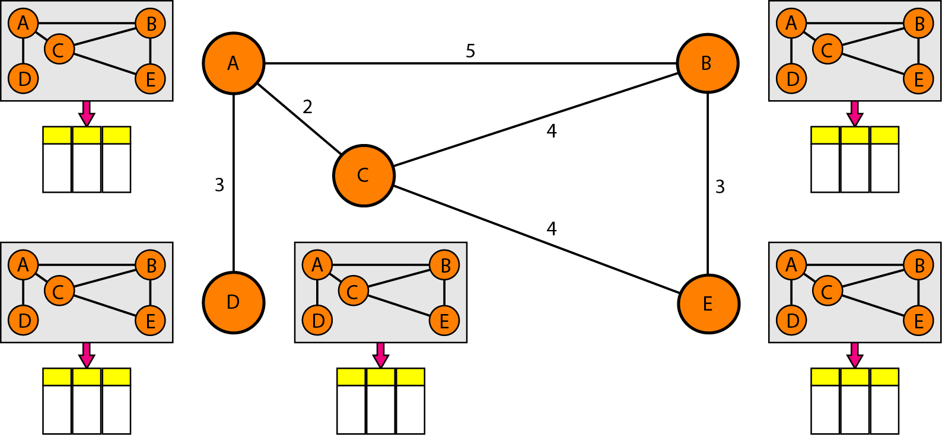
Link State Routing (Cont.)
In link state routing, topology information must be dynamic, i.e. representing latest state of each node and each link.
Hence, if there are changes in any point in the network (e.g. a link is down), the topology must be updated for each node.
Concept of link state routing

Slide 26
Link State Routing (Cont.)
Q) In link state routing, how can a common topology be dynamic and stored in each node?
A) Link state routing is based on the assumption that each node has “partial knowledge” of the topology, where it knows the state of its links (i.e. condition and cost).
As a result, the whole topology can be compiled from the partial knowledge of each node.

Slide 27
Building Routing Tables
Four sets of actions are required to ensure that each node has the routing table showing the least-cost node to every other node:
Creation of links states by each node, through a link state packet (LSP).
Dissemination of LSPs to every other router, through flooding, in an efficient and reliable way.
Formation of a shortest path tree for each node.
Calculation of a routing table based on the shortest path tree.

Slide 28
Creation of Link State Packet
A LSP can carry large amount of information, including node identity, list of links, a sequence number and age.
Node identity and the list of links are needed to make the network topology.
The sequence number facilitates flooding and distinguishes new LSPs from old ones.
The age prevents old LSPs from remaining in the domain for a long time.

Slide 29
Creation of Link State Packet (Cont.)
LSPs are generated on two occasions:
When there is a change in the topology of the domain.
On a periodic basis:
It is done to ensure that old information is removed from the domain.
The timer set for periodic dissemination is normally in the range of 60 min or 2 h based on the implementation.
A longer period ensures that flooding does not create too much traffic on the network.

Slide 30
Flooding of LSPs
After a node has prepared a LSP, it must be disseminated to all other nodes in the Autonomous System, not only to its neighbors.
The above process is called flooding and is based on the following:
The creating node sends a copy of LSP out of each interface.
A node that receives a LSP compares it with the copy it may already have. If newly arrived LSP is older than the one it has (by checking sequence number), it discards the LSP. If it is newer, the node does the following:
Discards the old LSP and keeps the new one.
Send a copy of the packet out of each interface except the one from which the packet arrived.

Slide 31
Formation of Shortest Path Tree
In link state routing, tree is a graph of nodes and links; where one node is called the root.
What we need for each node is a shortest path tree with that node as the root.
Shortest path tree: a tree in which the path between the root and every other node is the shortest.

Slide 32
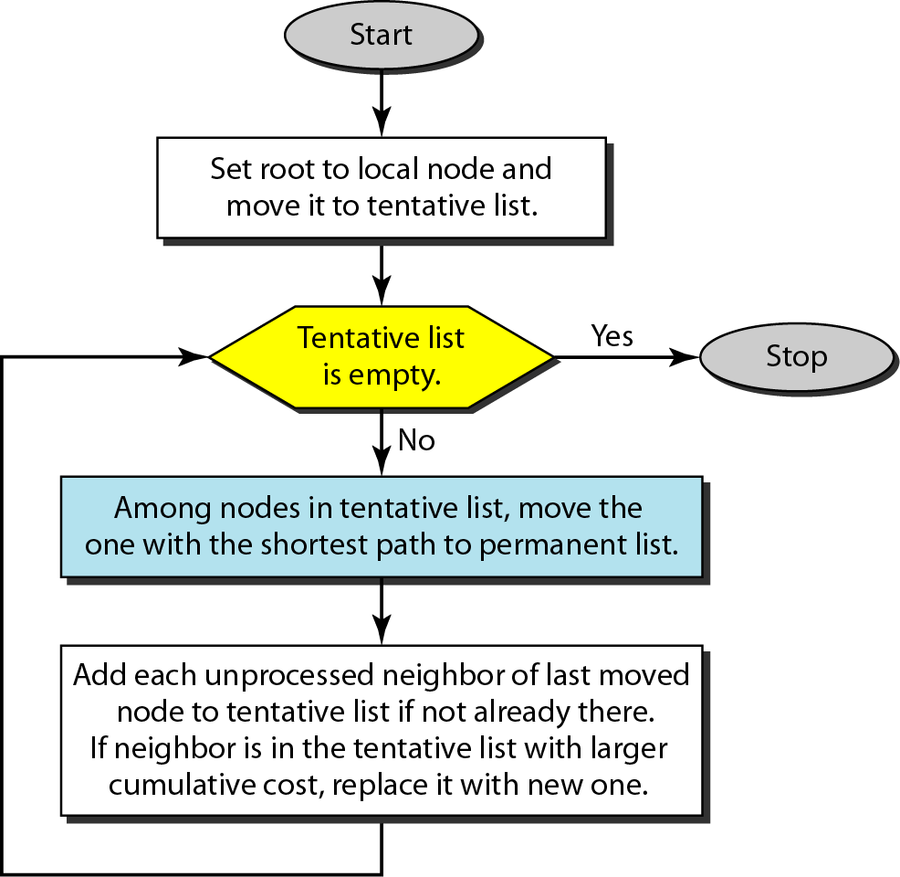
Formation of Shortest Path Tree (Cont.)
The Dijkstra algorithm creates a shortest path tree from a graph.
The algorithm divides the nodes into two sets: tentative and permanent.
It finds the neighbors of a current node, makes them tentative, examines them, and if they pass the criteria, makes them permanent.

Slide 33
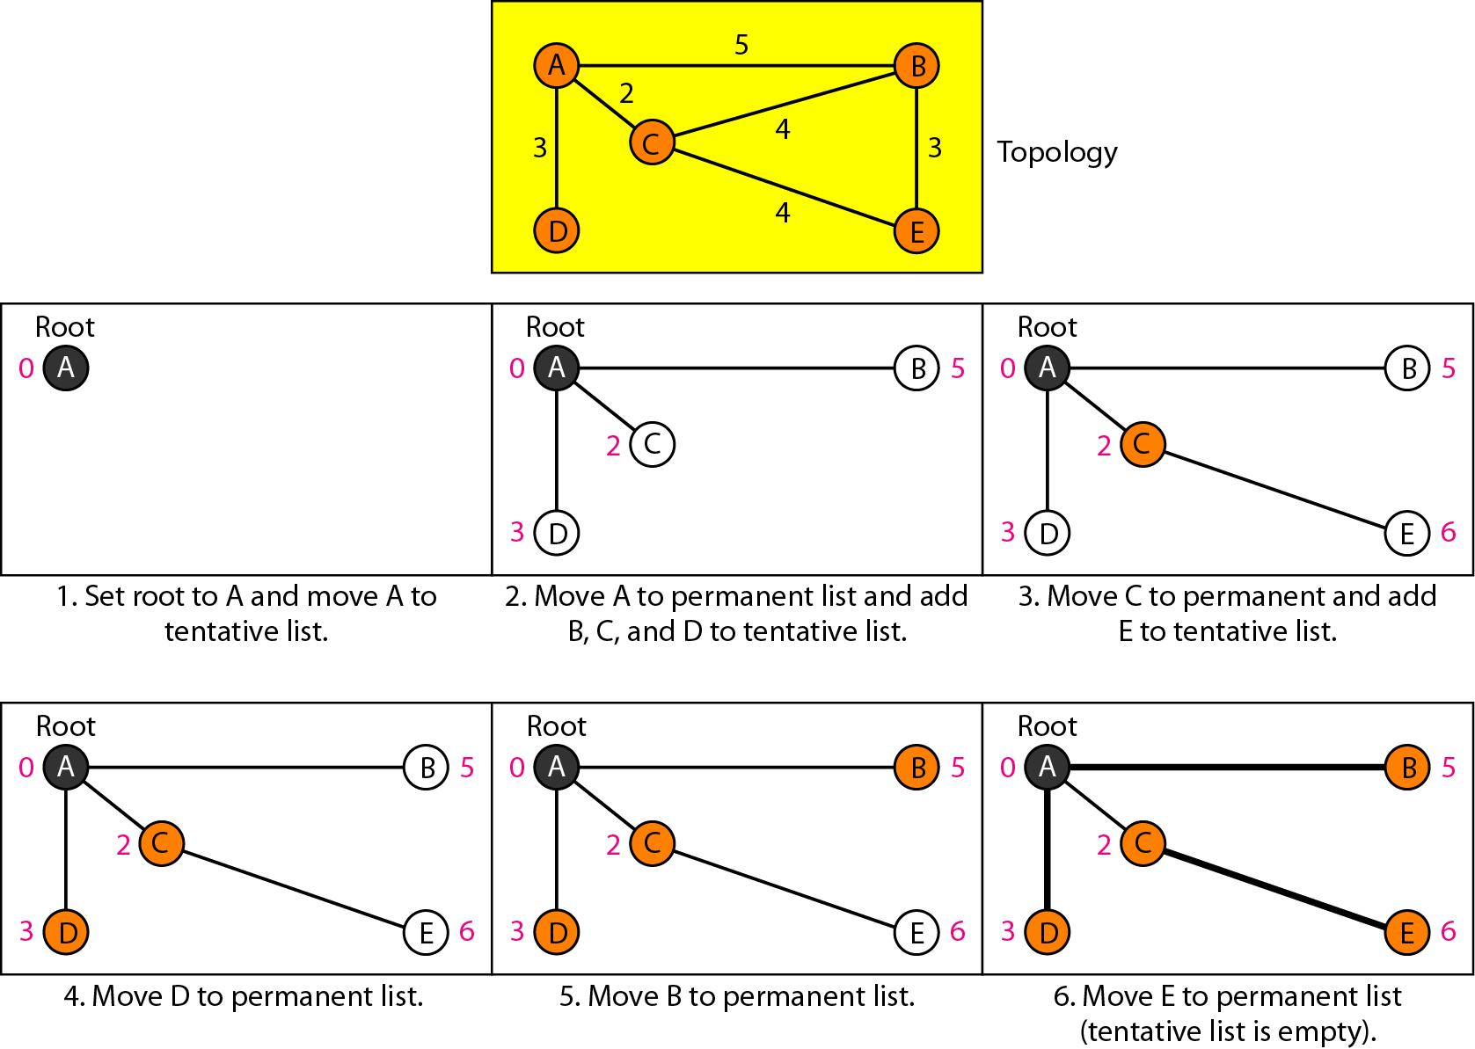
Permanent list Node A | Tentative list
Empty | A(0)
A(0) | B(5),C(2),D(3)
A(0),C(2) | B(5),D(3),E(6)
A(0),C(2),D(3) | B(5),E(6)
A(0),B(5),C(2),D(3) | E(6)
A(0),B(5),C(2),D(3),E(6) | Empty
Permanent list Node B | Tentative list

Slide 34
Example of formation of shortest path tree

Slide 35
Calculation of Routing Table from Shortest Path Tree
Each node uses the shortest path tree protocol to construct its routing table.
The routing table shows the cost of reaching each node from the root.
Table below shows the routing table for node A’s example.

Slide 36
Thank You!

